Slide 1
IPRs AND KNOWLEDGE DRIVEN ECONOMIES LATIN AMERICA

Slide 2
Role of IP
Ability to generate prosperous and innovative markets
Establish conditions that proliferate social and economic development

Slide 3
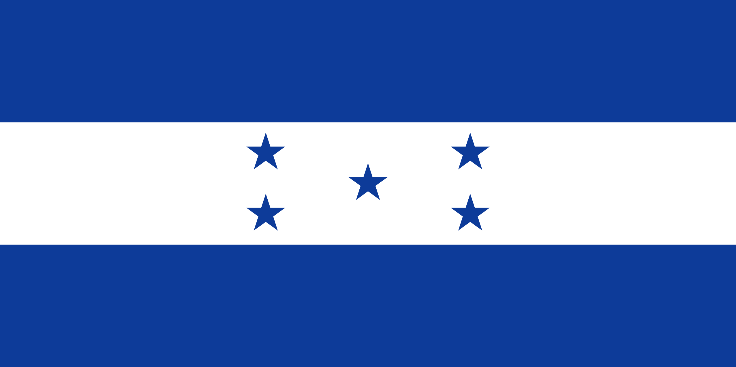
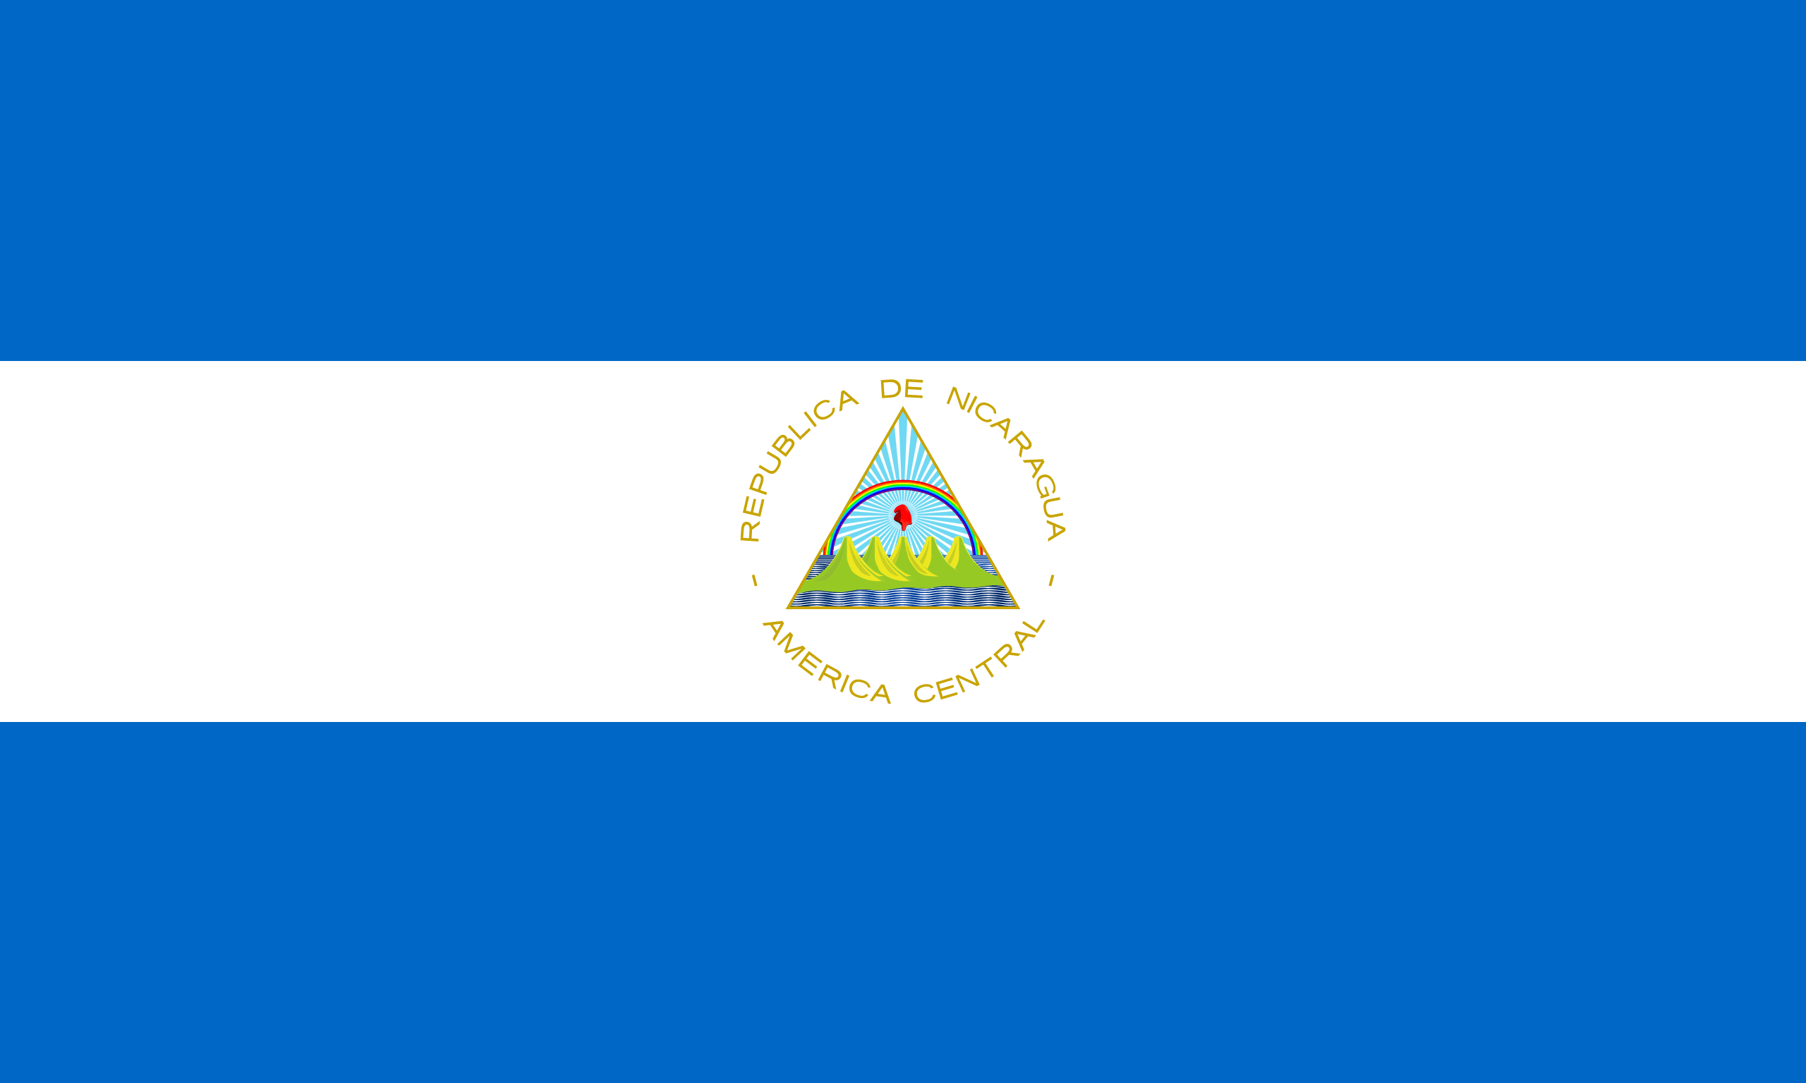
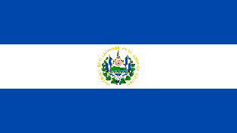
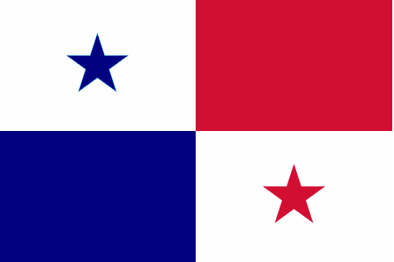
CENTRAL AMERICA
BELICE (French)
HONDURAS (Spanish)
COSTA RICA (Spanish)
NICARAGUA (Spanish)
EL SALVADOR (Spanish)
PANAMA (Spanish)
GUATEMALA (Spanish)
MEXICO (Spanish)

Slide 4
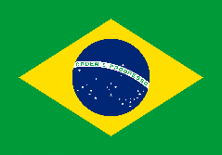
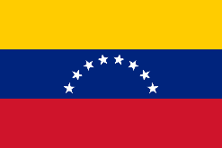
South America
ARGENTINA (Spanish)
ECUADOR (Spanish)
BOLIVIA (Spanish)
PERU (Spanish)
BRAZIL (Portuguese)
URUGUAY (Spanish)
VENEZUELA (Spanish)
CHILE (Spanish)
FRENCH GUIANA (French)
COLOMBIA (Spanish)

Slide 5
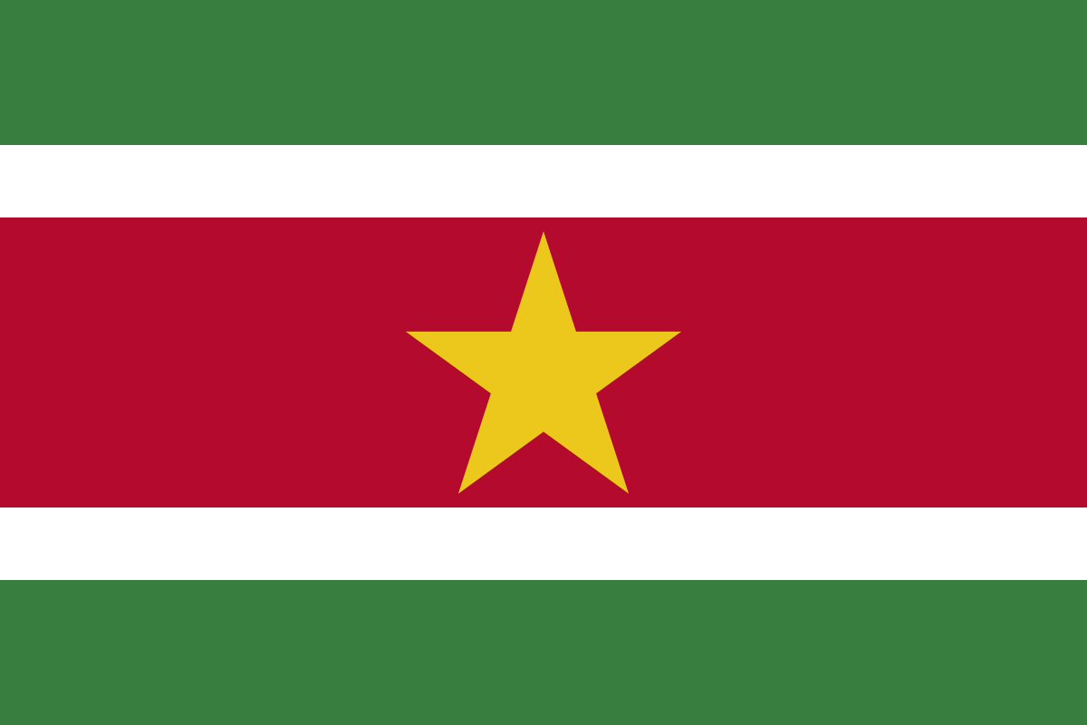
South America
GUYANA (English)
SURINAM (Dutch)
PARAGUAY (Spanish)

Slide 6
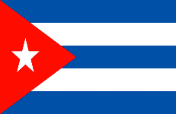
The Caribbean
ANGUILA (English)
BONAIRE (English)
Antigua and Barbuda (English)
St. Eustace (Dutch)
ARUBA (Dutch)
Saba (Dutch)
BAHAMAS (English)
Cayman Islands (English)
BARBADOS (English)
Cuba (Spanish)

Slide 7
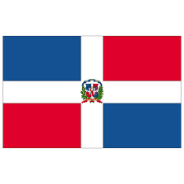
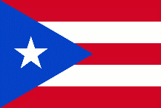
The Caribbean
Curaçao (Dutch)
Jamaica (English)
Dominica (English)
Dominican Republic (Spanish)
Grenada (English)
Puerto Rico (English and Spanish)
Guadalupe (French)
Martinique (French)
Haiti (French)
Montserrat (English)

Slide 8
The Caribbean
St. Bartholomew's (French)
St. Vincent and the Grenadines (English)
St. Kitts and Nevis (English)
TRINIDAD Y TOBAGO (English)
St. Lucia (French and English)
Turks and Caicos Islands (English)
St. Martin (English)
United States Virgin Islands (English)
St. Martin (Dutch)
British Virgin Islands (English)

Slide 9
The Caribbean
MALVINAS (English)
SOUTH GEORGIA AND SOUTH SANDWICH ISLANDS GEORGIAS DEL SUR Y SANDWICH DEL SUR (English)

Slide 10
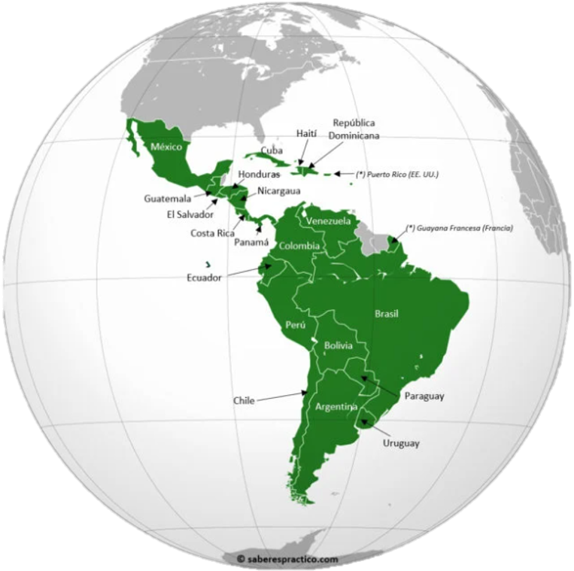
Panorama in Latinamerica
Characterized by:
Its Plurality
Diverse criteria – Society, Culture, Language and Economy.
https://www.trademap.org/Product_SelCountry_TS.aspx?nvpm=3%7c340%7c%7c%7c%7cTOTAL%7c%7c%7c2%7c1%7c1%7c2%7c2%7c1%7c1%7c1%7c1%7c1

Slide 11
Argentina Exports

Slide 12
Argentina Imports

Slide 13
Brazil Exports

Slide 14
Brazil Imports

Slide 15
Mexico Exports

Slide 16
Mexico Imports

Slide 17
Panama Exports

Slide 18
Panama Imports

Slide 19
Costa Rica Exports

Slide 20
Costa Rica Imports

Slide 21
Guatemala Exports

Slide 22
Guatemala Imports

Slide 23
Regarding the IPRs statistics in Honduras, there are being filed annually around 3,000 trademarks and 300 patents.

Slide 24
Under the current Honduran Industrial Property Law, registered marks that have not been used in Honduras for three years or more, counted from the registration date, may be subject to cancellation on the grounds of non-use and following a simple petition from an interested third party.
In order to avoid a cancellation action of non-use, the non-use or rehabilitation taxes must be paid every three years.

Slide 25
Honduras has signed the following trademark agreements :
•The Paris Convention for the Protection of Industrial Property (Paris Convention) 1883, member since 4 February 1994;
•The Buenos Aires Convention on Literary and Artistic Copyright (Third Pan-American Convention);
•The Washington General Inter-American Convention for Trademark and Commercial Protection (Pan-American Convention) 1929;
•The Convention Establishing the World Intellectual Property Organization (WIPO Convention) 1967, member since 15 November 1983;
•The Central American Convention for the Protection of Industrial Property 1968; and
•The Protocol to the Central American Convention for the Protection of Industrial Property 1968; and
•The Agreement on Trade-Related Aspects of Intellectual Property Rights (TRIPS Agreement) 1994, members since 1 January 1995.

Slide 26
Objective:
Form and consolidate a network of experts in intellectual property throughout Latin America to level the playing field for intellectual property in the region and turn its markets into attractive and competitive spaces for new investments (IP KEY, 2021).

Slide 27
IP Key Latin America Project https://ipkey.eu
The Project will focus in Chile, Mexico, the Andean Community (Colombia, Ecuador, Peru), Central America (Costa Rica, Guatemala, El Salvador, Honduras, Nicaragua, Panama), and Mercosur (Argentina, Brazil, Paraguay, Uruguay). It will operate for a period of three years and will work in areas related to trade agreements that have already been signed or are being negotiated between the EU and Latin America. It will also work on improving the level of protection and promotion of IPRs for the benefit of businesses and citizens.

Slide 28
The EU recognizes the value and impact that the Latin Region can have in the future and that is why it has focused on generating projects aimed at providing a range of new opportunities for both individuals and companies.

Slide 29
CONCLUSIONS
It is expected with the promotion of the IP Key Latin America project that the development of Intellectual Property in the region will take a leading role in the regional Latin agenda, resulting in greater protection and investment in the Latin markets, which in turn will translate into better economic conditions favorable to foreign investment and global trade relations.
It is not unreasonable to think that aiming to develop commercial relations, whether public or private, represents an optimal investment opportunity for the future.

Slide 30
Thank you for your attention!

